Slide 1
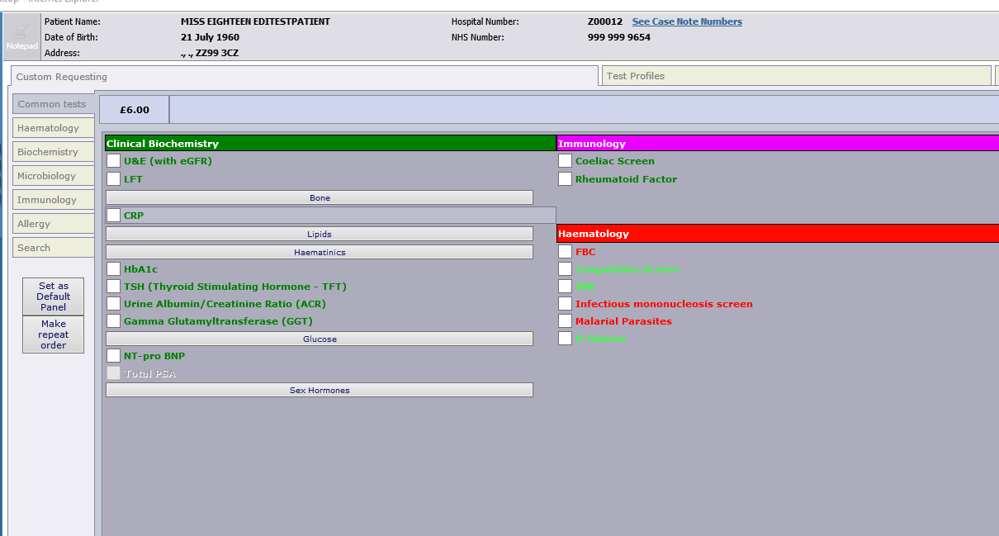
To access the lists of RDC bloods to undertake prior to referral
Select the “Test Profiles” lab on the top right hand side

Slide 2
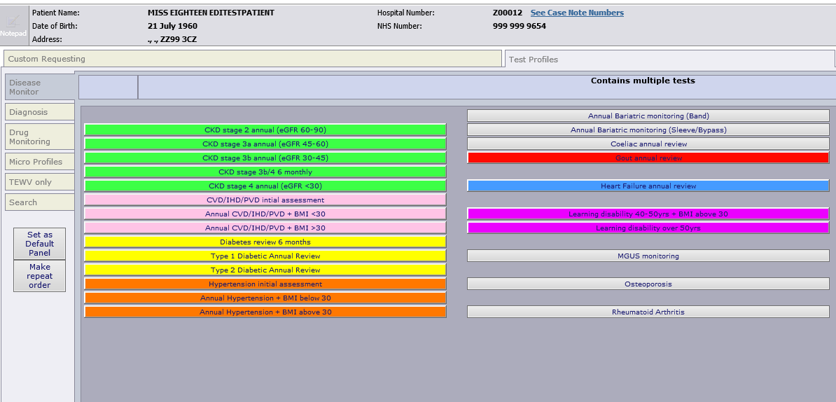
Select “Diagnosis” on the left hand side of the screen

Slide 3
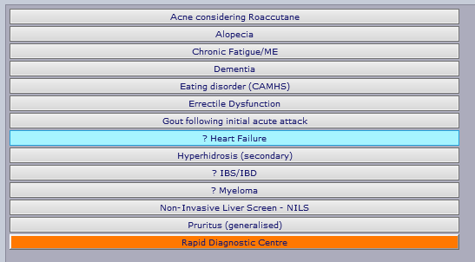
Click on the button for Rapid Diagnostic Centre (red arrow)

Slide 4
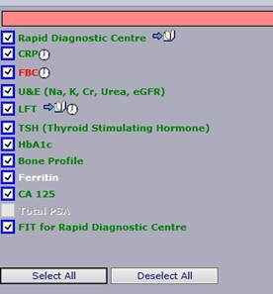

All the tests will automatically select
Answer any other questions that appear (e.g. is patient on thyroxine)
Press “Ok” to continue
Please note that FIT is now included in the panel as of 6th December 2021
Tests that are not relevant (e.g. CA125 in this male patient) will not be requested

