Slide 1
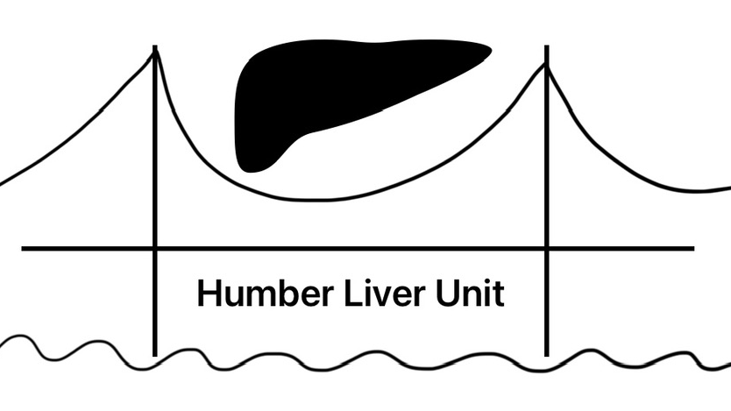
Suspected cancer or obstructive disease on imaging = Refer 2ww/surgery as appropriate
Investigation of suspected liver disease in primary care
Liver steatosis on imaging
Persistent abnormal LFT
NILS positive
Virus serology
HBsAg+ = Refer to Inf. Diseases (ID)
HCV Ab+ = check PCR; if + refer ID, If - = cleared HCV (manage as NILS -)
Antibodies
Smooth muscle or Anti-mitochondrial + = Refer liver clinic/discuss via A&G
High ferritin
Check transferrin saturation
If raised, refer/discuss via A&G
If normal, manage as NILS -
Clinical concern at any point: Discuss via Trust Hepatology Advice & Guidance or Gastro on call
USS + NILS* + Risk factors for liver disease
Tests are only valid in the population they are intended for. Fibroscan/ELF/Fib4 cannot be interpreted outside this pathway in primary care, and can cause unintended harm if used outwith these specifications
NILS negative
None of these
Metabolic risk factors (DM/obesity/T2DM etc.)
Metabolic risk factors + alcohol >14 u/wk, but <35 u/wk F; 50 u/wk M
Alcohol-related liver disease suspected
(>35u/wk F; >50u/wk M)
* NILS = non-invasive liver screen: liver specific antibodies, hepatitis B surface antigen (HBsAg), hepatitis C antibody (HCV Ab), ferritin, α1-AT
+ Add Fib4 where MASLD/MetALD/ArLD suspected
Manage alcohol risk
If suspected AUD, refer to community alcohol services
Consider alternative diagnosis -
Discuss via A&G/refer liver clinic
MASLD
MetALD
ArLD
Fib4$
Low risk <65 Low risk 65+
<1.3** <2
Increased risk
> 1.3- <65yr); > 2 (65+)
**Fib4 values in over 65s:
< 2 = Low risk;
> 2 = Increased risk
Manage risk factors in
Community (N.B. liver disease is not a contraindication to statin use)
Repeat 3yr if ongoing risk factors
Key:
MASLD = Metabolic dysfunction associated steatotic liver disease (prev. NAFLD)
ArLD = Alcohol-related liver disease
MetALD = Metabolic and alcohol risk factors
AUD = Alcohol Use Disorder
ELF or Fibroscan if available in primary care/CDC, otherwise discuss via A&G/refer liver clinic
ELF <9.8 or Fibroscan <10
ELF >9.8 or Fibroscan >10
Refer liver clinic

