Slide 1

Gateway Training Webinar
Haxby Group

Slide 2
No. | Agenda Item
1. | Introduction and background to Gateway
2. | Training Videos
3. | Next Steps and Questions

Slide 3
Referral Optimisation across HNY
A Referral Optimisation Programme has been established – focussing on pathways, referral criteria, referral processing and new referral models (e.g. national SPOA).
We need to work differently if we are to shift resources around our pressured system. We need to support GPs in making the right referral to the rights service at the right time. We want patients to get to the right place first time, using clinical pathways to help direct patients to the most appropriate service.
HNY ICB have invested in a proven and popular referral support model that has been deployed in GP practices in York & Scarborough for over 10 years and recently with Optometrists.
New ICB investment means this model can now be rolled out across the rest of HNY ICB.
The referral support model has two key components – Gateway which is a digital tool to make referrals and the RSS team, who get involved and help process a sub-set of referrals. The model has many benefits to patients, general practice, the acute sector and the wider system.

Slide 4
What is Gateway?
Gateway is a digital solution produced by a company called Accenda. It is used by referrers to generate a referral. There is no cost to the referrer for using Gateway. The ICB have purchased Gateway for the whole of the ICS.
When a referral is generated, relevant parts of the patient record are automatically added to the referral and it will prompt you to click a button to add additional information e.g. ECG. It can do this because it fully integrates with SystemOne. The referrer does not need to download any software to make Gateway work.
Gateway achieves better outcomes than using the national referral tool e-RS in these ways:
It automatically populates the referral with parts of the patient record.
It guides the referrer to provide relevant pieces of information needed for the provider to accept the referral into the relevant clinic, so the patient arrives at the right place first time and is worked up, ready for their appointment.
It provides a more sophisticated platform for enabling advice & guidance e.g. saving 2 way conversations between referrer & specialist directly into the GP patient record

Slide 5
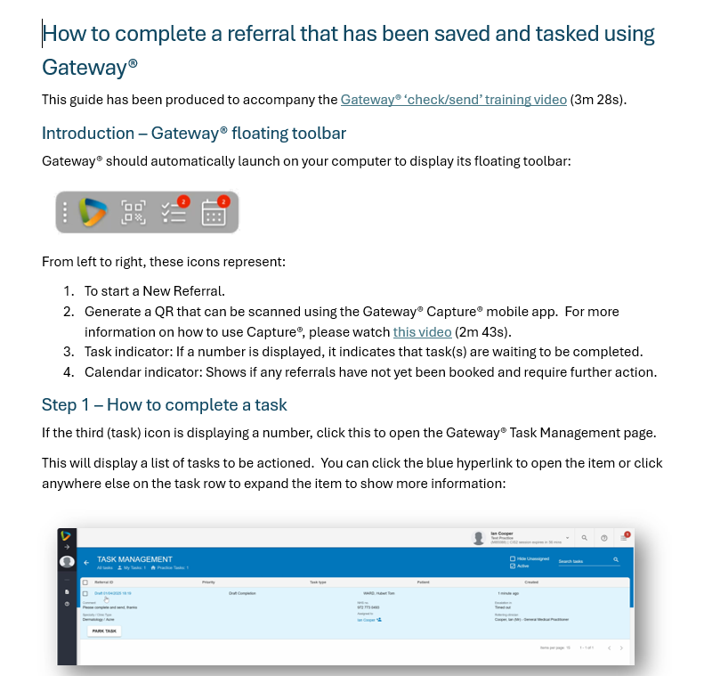
Gateway Training Proposal
Setup and Admin Guide
  Gateway has been pushed out to practices with simple setup process via N3i
  Toolbar needs to be downloaded by practice
  User guide developed by Gateway—intuitive and easy to follow
Support for Senior Managers &
Clinicians
  Highlight differences for clinicians and how the system improves processes & referrals
  Fits into current workflows (S1, EMIS, eRS)
  Session can be delivered for clinicians, with input from GPs and the project team
  Clarity on handoff points in practice team
Webinar & Training for Administrators
  Virtual demonstration on system use, including change from eRS
  Virtual training and in-person where beneficial
  Local resources to support Referral Mx
Ongoing Support
  Dedicated support via 0300 phone number and email, provided by RSS team with over 10 years’ experience
  Experience in building strong stakeholder relationships and user groups
  Technical support provided by Accenda

Slide 6

Gateway introduction

Slide 7
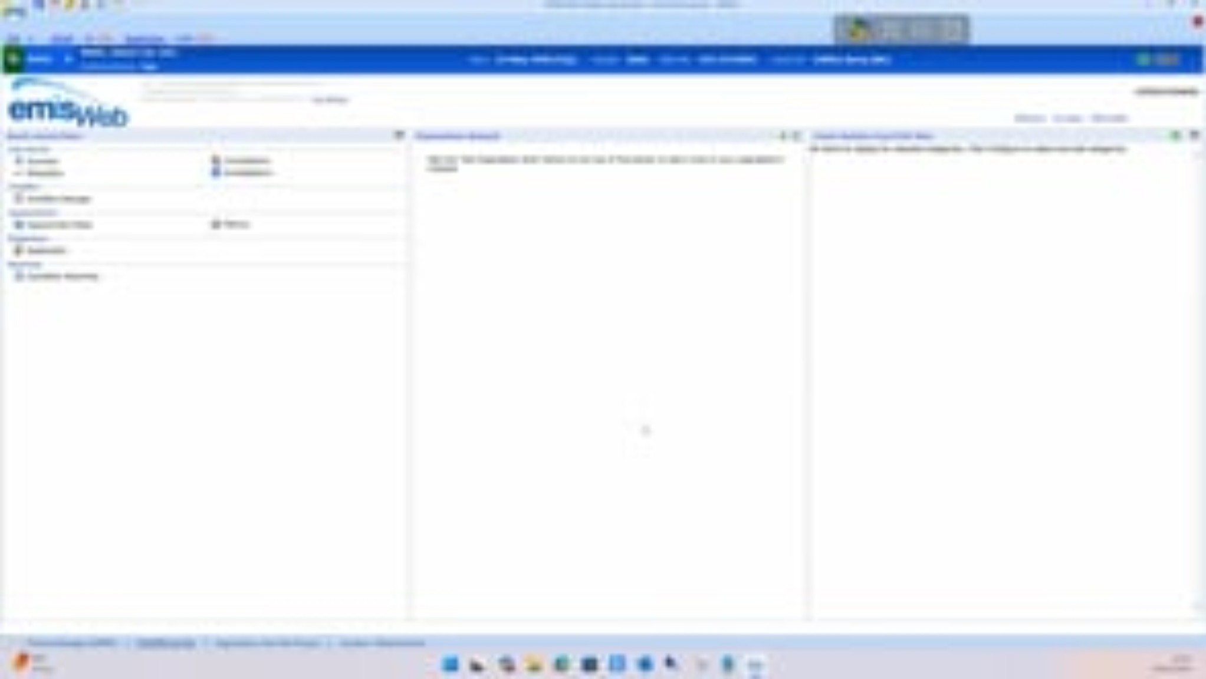
Creating a New Referral

Slide 8

Creating a new referral request with pathway questions

Slide 9

Submitting Advice & Guidance request

Slide 10

Managing A&G responses

Slide 11
Next Steps and Query Support
Bringing all worklists from eRS into Gateway: We are currently working with Accenda to bring all worklists into Gateway including rejected referrals enabling practice staff to solely use Gateway.
FAQs and How-to Guides: The RSS team will work with your practice to build on similar work they’ve done with York practices to provide a ‘Booking Guide’. It will work as a quick reference guide for anything related to referrals.
  We will also be asking you to complete a questionnaire 6 and 12 weeks post implementation.
Bringing other referrals into Gateway: We are also working with your practice and Accenda to include ALL referrals into Gateway including those being sent to email inboxes, this will take some development time but will significantly improve referral processes.
Contact the RSS team: 0300 303 8676 or hnyicb-voy.rsservice@nhs.net
Contact for Gateway Helpdesk - Mon to Fri 8am to 6pm: 0161 274 9730 or support@accenda.co.uk

