Slide 1
Case for Change: Referral Optimisation Programme
IMPROVING PATIENT CARE, EFFICIENCY, AND SYSTEM PERFORMANCE
The need to get it RIGHT has never been GREATER

Slide 2

Agenda
Purpose and Rationale for Change
Our Approach and Programme Structure
Gateway Features and Benefits
Benefits for Patients
Benefits for General Practice
Benefits for Secondary Care and the System
Clinician and User Testimonials

Slide 3

This is not new – it’s proven, trusted, and ICB-backed
This is ICB investment in primary care.
The ICB is investing in a proven and popular referral support model that has been successfully deployed in GP practices in York & Scarborough for over 10 years.
All optometrists are already using this model for cataract referrals.
Expansion, not invention.
We are expanding what already works: the Gateway digital referral tool and the RSS team.
This is not a new or untested approach, it’s a system that has delivered benefits for patients, practices, and providers for years.
Now available to all.
ICB investment means this model can now be rolled out across the rest of Humber and North Yorkshire ICB.
There is no cost to general practice, this is ICB investment in supporting General Practice, system partners, and patients.

Slide 4
Purpose and Rationale for Change

Slide 5

Programme objectives
The Referral Optimisation Programme (ROP) aims to:
Improve compliance with the ICB's commissioned policies
  Ensure clinical policies are adhered to, eliminating inappropriate referrals for treatments patients are not eligible for.
Reduce the volume of referrals received by secondary care
  Maximise productivity and efficiency by ensuring clinical pathways are followed.
Enhance patient experience and outcomes
  Patients receive timely specialist advice and input.
  Waiting lists are reduced, allowing secondary care to reduce costs and commissioners to remove waiting list incentive schemes.
Support system-wide transformation
  Enable other priority programmes by reducing waiting lists and releasing funding elsewhere in the system.
Facilitate delivery through stakeholder management, engagement, and communication
  Ensure internal and external stakeholders understand, support, and champion the programme and its benefits.

Slide 6

Need for Change - The need to get it right has never been greater
Clinical policies are not always followed:
Patients are sometimes referred for treatments they are not eligible for, leading to poor patient experience and clinically ineffective treatment.
Clinical pathways are inconsistently available and followed:
Referring clinicians may lack awareness, be uncertain about referral destinations, or be unwilling to follow set pathways, causing inefficiencies and poorer patient experiences.
General Practice clinicians could manage more patients outside hospital:
With appropriate support, more care could be delivered in the community, improving patient experience and supporting the NHS's 'left shift' ambition.
Patients waiting for outpatient appointments are not always optimally managed:
This can result in harm, reduced chances of good clinical outcomes, and generally poor experiences.
Strategic alignment:
The programme responds to national NHS priorities, including operational planning guidance and financial reset expectations, and supports the NHS 10-year plan's ambition to move care closer to home.

Slide 7

Strategic alignment and system priorities
Optimising Referral Management
  NHSE guidance calls for improved referral systems using specialist advice, triage, PIFU, and direct test pathways.
Demand Management Focus
  NHSE guidance and leadership letters highlight exploring demand management to control system pressures and improve patient flow.
Shift to Community Care
  Service models emphasise moving care from secondary to community settings, supporting the NHS 'left shift' ambition.
Priority Programmes and Recovery
  ROP is a key priority in ICS recovery plans, reducing waiting lists and increasing system efficiency and funding.

Slide 8
Our Approach and Programme Structure

Slide 9

Building Blocks of System-Wide Transformation
The programme is structured around key building blocks that underpin our collective system recovery and transformation efforts. These components are aligned with NHS England’s operational guidance and support integrated working across the Humber and North Yorkshire system.
Digital Repository & Gateway
A centralised digital platform (Gateway) streamlines GP referrals and supports advanced triage for complex cases.
The digital repository enables consistent access to clinical policies and referral guidance.
Harmonisation of Clinical Policies
Clinical policies are being standardised across the system to reduce variation and improve consistency in care delivery.
Cross-Interface Clinical Pathways
An increasing number of clinical pathways are being agreed across care interfaces, with a focus on priority specialties such as Gynaecology and MSK. These pathways ensure patients receive timely, coordinated care regardless of entry point.
Referral Support Services (RSS) Team
The RSS team provides hands-on support to clinicians, helping navigate complex referrals and ensuring patients are directed to the most appropriate care.
Stakeholder Collaboration
Strong stakeholder engagement strategies ensure that all partners are aligned, informed, and actively contributing to programme delivery.
Notes:
---

Slide 10
Gateway Features and Benefits

Slide 11
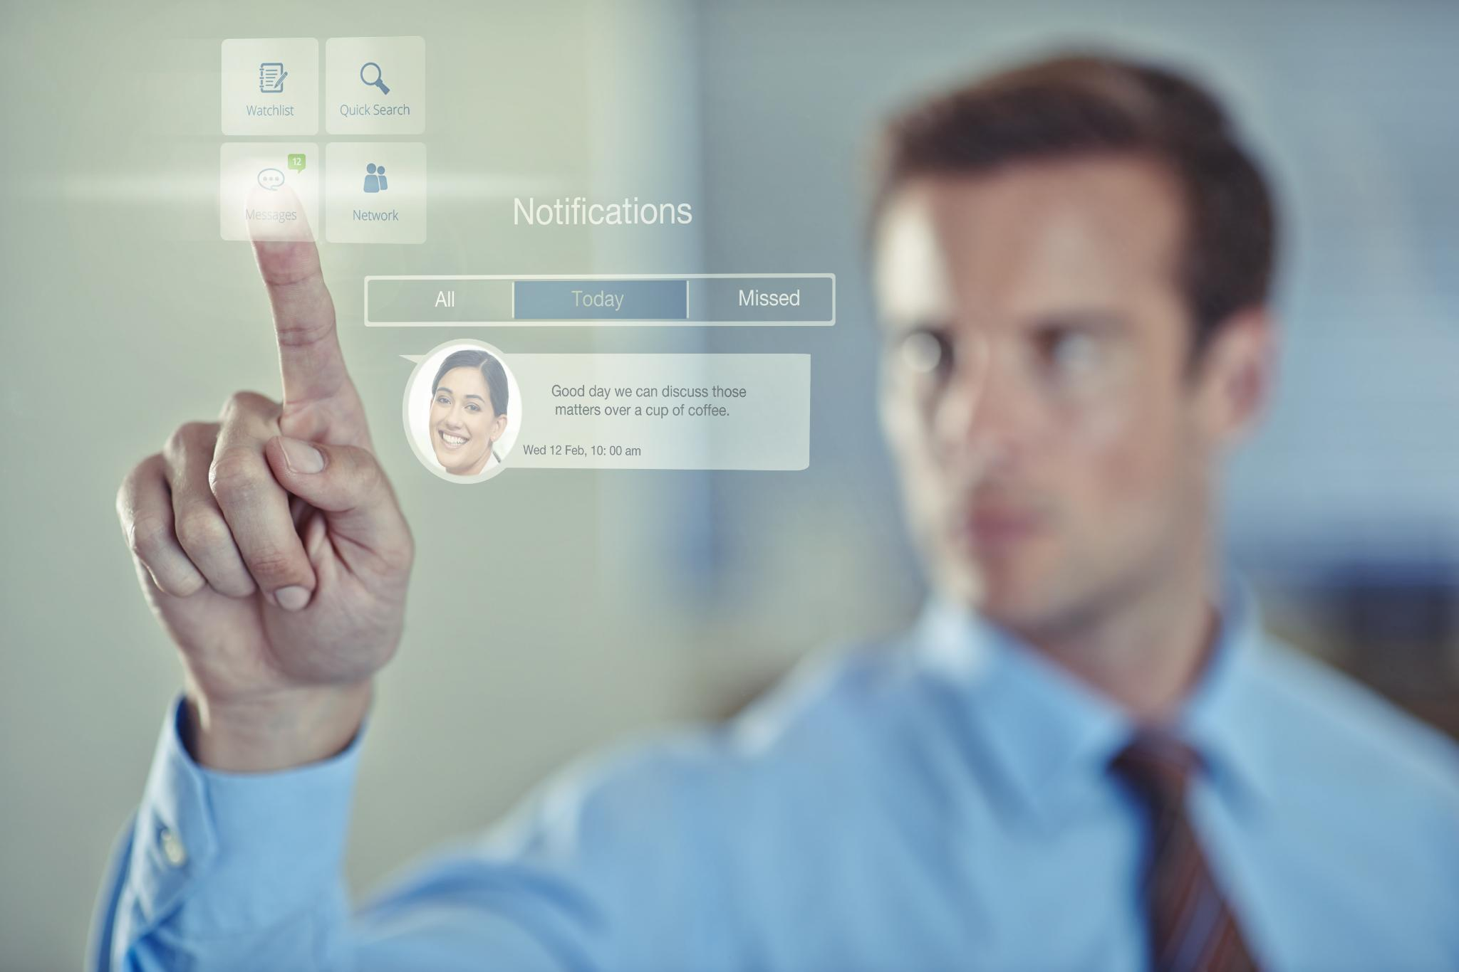
Gateway Functions
Clinical Validation Engine
  Digital forms ensure referrals are clinically appropriate by extracting and validating essential patient information.
  Clinical Platform
  Gateway® has evolved through listening and collaboration over the last 15 years and is now a clinical decision platform, where many clinicians are now directly creating referrals – improving clinical quality.
  Automatically routed
  With AutoRoute®, Gateway® can now automatically suggest the appropriate service for the patient pathway. Reducing unnecessary pressure on clinician-based Advice and Guidance, where algorithms can be used instead.
  Bookable Secondary Care Clinic Slots
  Trusts implemented RAS services as a way of controlling inappropriate activity. With Gateway® clinical validation, Trusts can define more granular clinical services trusting that AutoRoute® will ensure appropriateness, directing the patient onto the correct clinical pathway.
  Patient Choice
  Through direct integration with e-RS combined with our routing tools, practice staff can easily book patients into the correct service, offering choice directly or by allowing patients to book via the NHS App.

Slide 12



Not just for GPs
  Gateway® can be used from any user setting, just using a web-browser and NHS Care Identity (CIS2). Where Gateway® communicates with PDS, EMIS, SystmOne and e-RS.
Primary Care
Community Nurses
Secondary Care
Enhanced Access
Dentists
Opticians
e-RS
CIS2
PDS
NHSmail
Notes:
---

Slide 13
Benefits for Patients

Slide 14

Patient experience, choice, and outcomes
Benefits for Patients and Providers
  Patients experience shorter waiting times and care closer to home while providers get more appropriate referrals.
Enhanced Patient Choice
  The Gateway platform supports patient choice by offering intelligent recommendations and various booking options.
Flexible Booking Options
  Patients can book appointments themselves, choose from shortlisted providers, or have the practice book for them based on needs.
Improved Referral Efficiency
  Gateway reduces administrative time, prevents delayed referrals, and aids shared decision making between patients and providers.

Slide 15

Reduced waiting times and improved access
Timely Specialist Input
  Patients receive prompt specialist advice, enhancing patient experience and health outcomes.
Right Place First Time
  Clinical guidelines direct patients accurately, avoiding system delays and repeated visits.
Efficient Use of Gateway System
  Gateway takes slightly longer than e-RS but improves outcomes and system efficiency.
Reducing Repeat Appointments
  Gateway reduces misplaced referrals, freeing up appointments and streamlining care delivery.
Notes:
---

Slide 16
Benefits for General Practice

Slide 17

Ease of use, efficiency, and administrative impact
Flexible Referral Methods
  Clinicians can use various referral methods including copy-pasting notes or typing directly into the system, enhancing workflow flexibility.
Increased Efficiency
  Copying consultation notes speeds up referrals and linking multiple consultations reduces typing, saving valuable time.
Reduced Administrative Burden
  Gateway reduces admin tasks by empowering GPs to create referrals themselves, lowering admin team workload and costs.
Improved Patient Interaction
  GPs can generate referrals during appointments enabling better patient conversations and reducing repeat visits.

Slide 18

Support for clinical decision-making and shared care
Gateway Prompts Benefit
  Prompts in Gateway reduce the need to recall policy thresholds and prevent referral delays or rejections. This saves admin staff time and frustration.
  Facilitates Shared Decision Making
  Gateway supports shared decision making by providing useful information for discussions between clinicians and patients.
Referral Activity Monitoring
  Gateway helps monitor referral patterns, identifying areas where junior staff may need senior support to optimise patient management.
Integrated Medical History and Pathways
  Automatic inclusion of patient history and structured pathways reduces requests for additional information, enabling efficient advice and guidance.

Slide 19
Key Benefits of Gateway for Admin Staff
Easier, Faster Referral Process
Gateway is quicker to complete than a Word document referral. Admin staff no longer need to fill out slow, error-prone Word forms; instead, they use a streamlined digital system.
Reduces duplication, delay, and inefficiencies. Gateway helps get the patient to the right place the first time, reducing the need for repeat work or chasing missing information
Consistency and Standardisation
Ensures referrals are complete, clinically appropriate, and consistent across the system. Admin staff benefit from a standardised process, reducing variation and confusion about what’s required for each referral.
Integrated with GP Clinical Systems
Gateway is integrated with the GP clinical system. Admin staff can easily access patient records and referral templates, reducing the need to switch between systems or manually enter data.
Flexible Use
Doctors can still ask admin staff to process referrals. If GPs prefer, admin staff can continue to manage referrals, but with a much-improved, easier-to-use system
Better Communication and Audit Trail
All referral activity is tracked, making it easier for admin staff to follow up and resolve any queries
  .

Slide 20
Benefits for Secondary Care and the System

Slide 21

Secondary care efficiency and reduced inappropriate referrals
Streamlined Referral Process
  Gateway system simplifies referrals, saving time for doctors and secretaries by following structured pathways.
Cost Savings and Resource Optimisation
  Reducing inappropriate referrals frees acute slots and lowers costs, benefiting hospitals and community settings.
Data-Driven Referral Insights
  Gateway provides comprehensive data on referrals enabling better management of pathways and specialties.
Environmental and Social Benefits
  Avoiding unnecessary outpatient appointments reduces environmental impact and eases social and employment burdens.

Slide 22

System-wide resource optimisation and data insights
Reducing Waiting Lists and Costs
  Reducing outpatient infrastructure lowers costs and waiting lists across secondary care and improves patient choice.
Referral Support Model Efficiency
  The Referral Support Model stabilizes referrals, providing a single platform for consistent primary care referrals across the ICS.
Data Insights and Reporting
  Gateway platform offers robust referral data, full reporting, audit trails, and supports structured advice requests for improved oversight.
Provider Interaction and Integration
  Providers access advice and guidance activities digitally; Gateway supports automated messaging to provider systems for sustainability.

Slide 23
Clinician and User Testimonials

Slide 24

Clinician Testimonial
“I learned how to use Gateway in under 30 minutes. It's extremely easy to use and therefore really efficient”
“I know different clinicians and different practices get their referrals done in different ways[…] it works easily whatever your preferred system. I changed to just copy and click my consultation notes across as it was infinitely quicker than typing and sending tasks.”
“I don't always do a referral in a consultation because there isn't time. But where I do, I'll click the notes across to gateway and select the choice with the patient so they can understand the waiting times options there and then. This prevents a later discussion about whether or not they want to expedite, or consider private options, where I've got to then re-type or send A&G. It manages expectations better and we're able to talk about safety netting and any issues in waiting up front.”
“I find it difficult to remember all the commissioning policy thresholds each time. I find the prompts in Gateway useful as I don't have to look things up each time and it prevents rejected or delayed referrals.”
“Gateway has reduced my admin time relating to referrals, but it has also reduced the time patients wait for a referral to go through.”
“I think it's useful to see the referral activity in the practice. For example, we were able to easily spot when a more junior member of the team had high referral rates, generating a lot of admin and waiting for patients that could be managed more effectively with senior support. I didn't have visibility of that before and wouldn't have been able to see the opportunity to support them so clearly.”
“I have changed the way I work because I find it more efficient, but that's not an essential thing to do if other clinicians didn't want to do that. It has reduced admin costs for the practice in being more efficient. Our admin team find it easy and straightforward to use.”
GP practicing in York

Slide 25

Further Feedback
We love sending and receiving A&G's through Gateway – it is so much faster to send, get a response, and track the process. Being able to re-open A&G's and send further queries regarding the same topic from the GP through Gateway is so helpful – through eRS you have to close and re-start the process, and we have had multiple issues with following up on responses which we have not had with Gateway sent A&G's. Kirkbymoorside and Priory Medical Group GPs have expressed numerous times how easy the service is to operate, and how fast responses from clinicians are. We always say that we hope more services use Gateway for A&G's!
The function of moving the referral documents onto eRS is unbelievably helpful – we have said that eRS is not as user friendly as Gateway, so grateful for all help!
[…] has saved us an unbelievable amount of time and effort – GPs may forget results or not realised that they are mandatory for a pathway, and it helps us to not have the referral rejected at a later stage and have to resubmit – making the patient’s experience faster and more efficient.
Holly Jameson, Referral Management & Private Clients Team, Priory Medical Group

Slide 26
Further Feedback
“I find Gateway really good and easy to navigate.”
Tina Ball, Medical Secretary, Scarborough Medical Group
“A&G is really helpful for the four specialties we use, as it allows conversion to a referral if needed. The triage function works well—when a consultant replies, we let the referring GP know the outcome […] Transferring everything onto e-RS is fantastic, as it means if anything has been missed, we can go back and attach the missing documentation. Gateway is also good at pulling through all the necessary information [...]”
Jackie Popely, Medical Secretary, Unity Health GP Practice
I just use (Gateway) for 2WW referrals - but have found it quick, easy and efficient to use - just as simple as our previous system of completing forms for our secretaries to process, and without involving an extra step...
Dr Becky Field, GP - York Medical Group
The speed of response is fantastic with the two-way comms interface. I would also comment that Gateway is a more user-friendly interface than eRS in terms of simplicity and ease of use and is also simple to teach new team members.
Deborah Hague, Medical Secretary, Eastfield Medical Centre
I use Gateway in our practice for 2WW referrals. It is a reliable and up to date way of seeing the criteria and creating a referral. We are currently looking at the Gateway capture app as a way of reducing the steps in attaching dermatoscopic photos to patients records.
Dr Daniel Kimberling, GP Partner, Haxby Group Practice
Notes:
In summary, the Referral Optimisation Programme addresses critical challenges in referral pathways, delivering significant benefits across patients, general practice, secondary care, and the health system through collaborative stakeholder engagement and innovative technology.

Slide 27
Conclusion
Addressing Referral Challenges
The programme tackles key obstacles in referral pathways to improve healthcare efficiency and outcomes.
Benefits Across Healthcare
Patients, general practices, secondary care, and the health system all gain significant advantages from the programme.
Collaborative Stakeholder Engagement
Success is driven by cooperation among stakeholders working together in the referral optimisation process.
Innovative Technology Use
The programme integrates advanced technology to streamline and enhance referral systems effectively.
Notes:
In summary, the Referral Optimisation Programme addresses critical challenges in referral pathways, delivering significant benefits across patients, general practice, secondary care, and the health system through collaborative stakeholder engagement and innovative technology.

